Slide 2
What is an Apprenticeship?

Slide 3
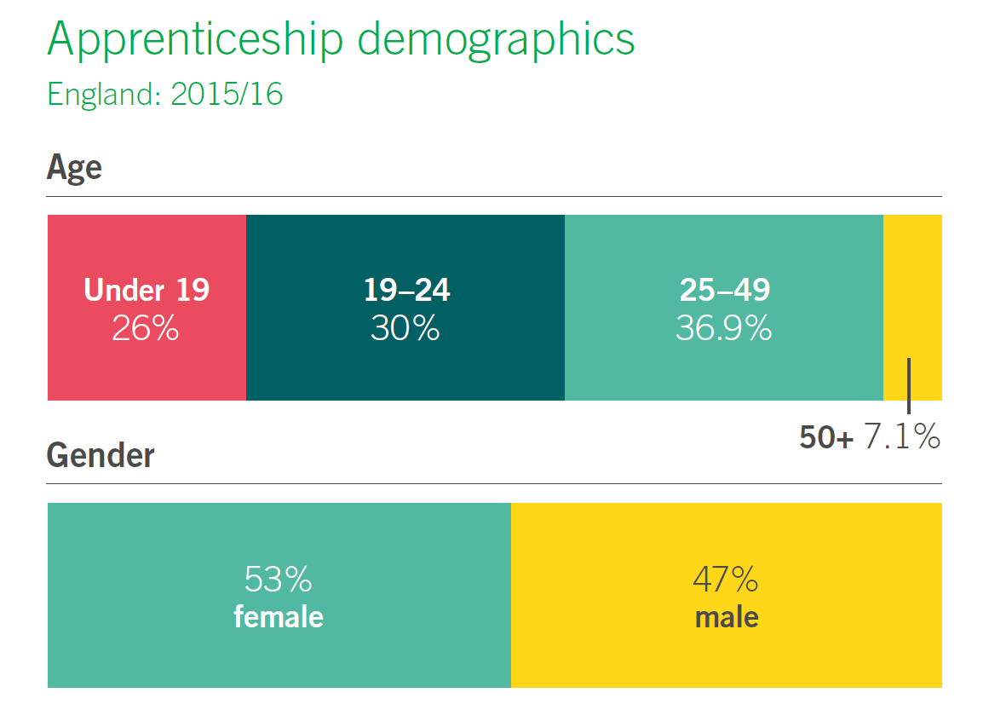
Who can do an apprenticeship?
There is no definitive answer…………..
Different entry requirements – depending on occupation, level, sector, employer
Must live in England
Must not be in full time education
Over 16 yrs – there is no upper limit
Committed to work and learning at the same time

Slide 4
Is an Apprenticeship right for me?

Slide 5
Over 520 apprenticeship standards have been published or in development, with over 200 that are approved for delivery.

Slide 6
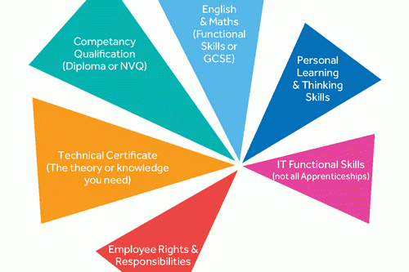
Each level will include some or all of these components

Slide 7
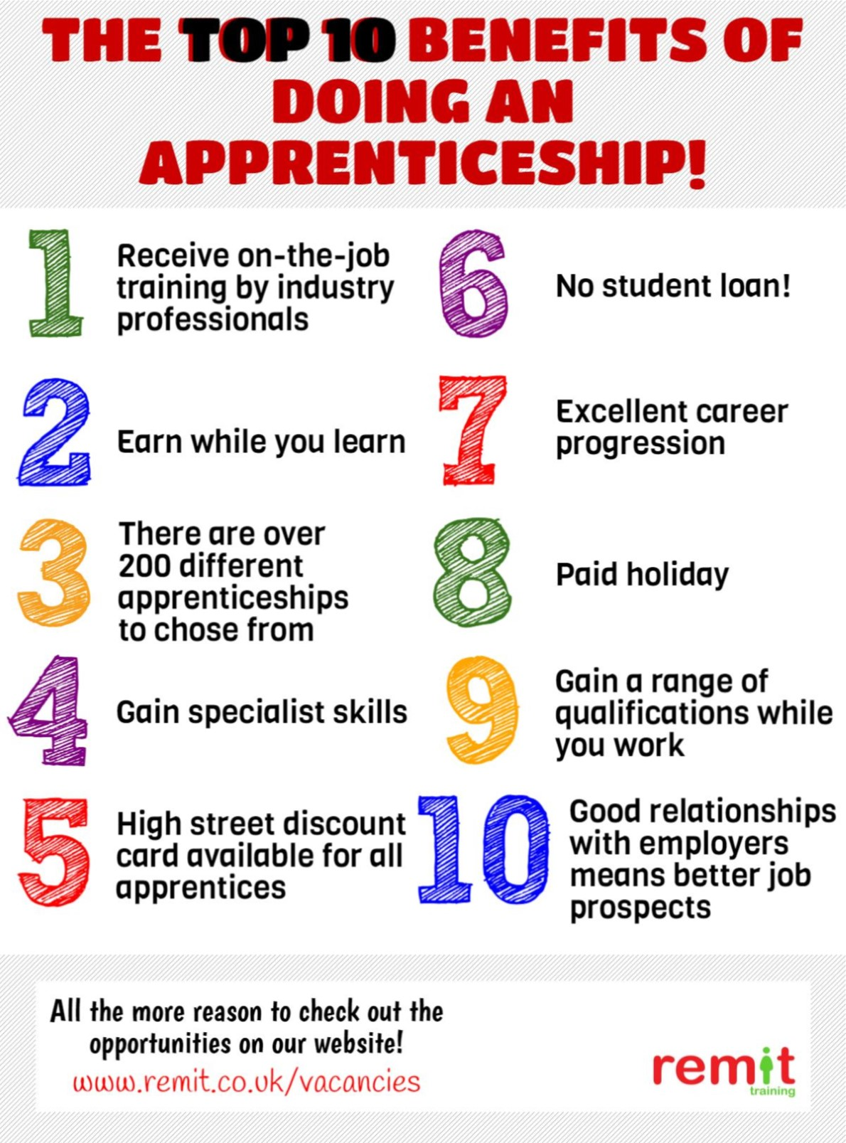
Top 10 benefits of doing an apprenticeship

Slide 8
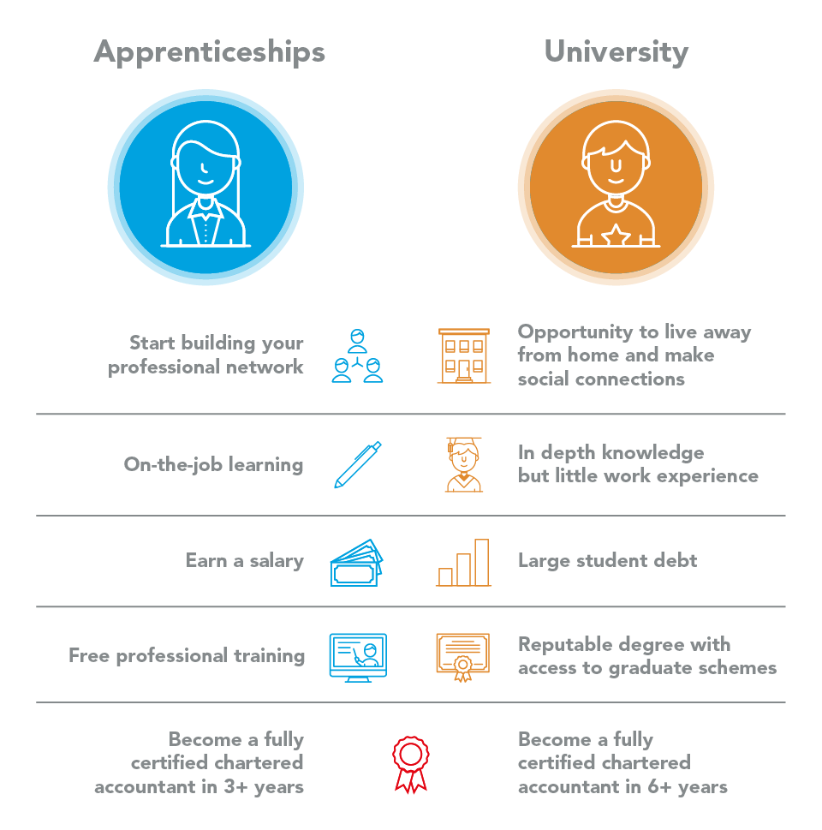
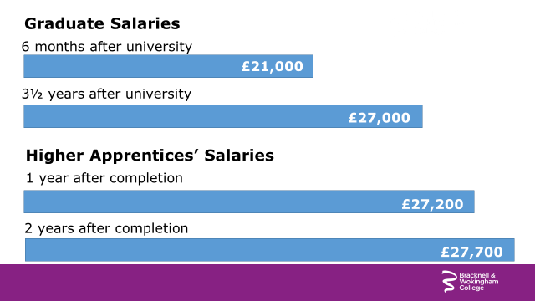
University or Apprenticeship?

Slide 9
We offer Apprenticeships in the following industries:
Accountancy
Arborist
Automotive
Business Administration
Childcare
Construction (Brick, Plumbing, Carpentry)
Customer Services
Electrical
Engineering
Equine
Furniture
Golf Greenkeeper
Hair and Beauty
Healthcare
Horticulture
Hospitality and Catering
Human Resources
IT
Sports Turf
Some are rolling programmes that can start throughout the year * Attendance in college could be weekly, bi-weekly, monthly

Slide 10
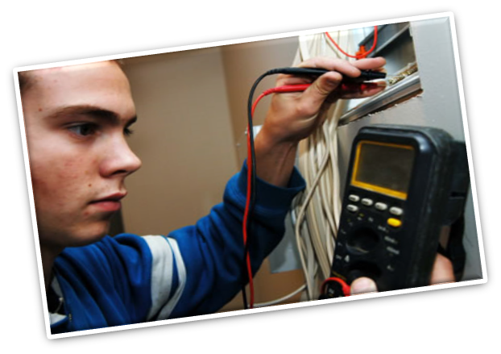
What does Activate Learning do to support you:
We interview, assess and advise
Assist you with gaining an apprenticeship and employment
Obtain funding
Complete a full College and workplace induction
Offer teaching and workshops (where appropriate, either weekly,
bi-weekly or monthly) )
Monitor and support you throughout your Apprenticeship

Slide 11
Who we work with

Slide 12
Some employers we work with

Slide 13
What happens next?
https://www.bracknell.ac.uk/courses/apprenticeships/vacancies

Slide 14
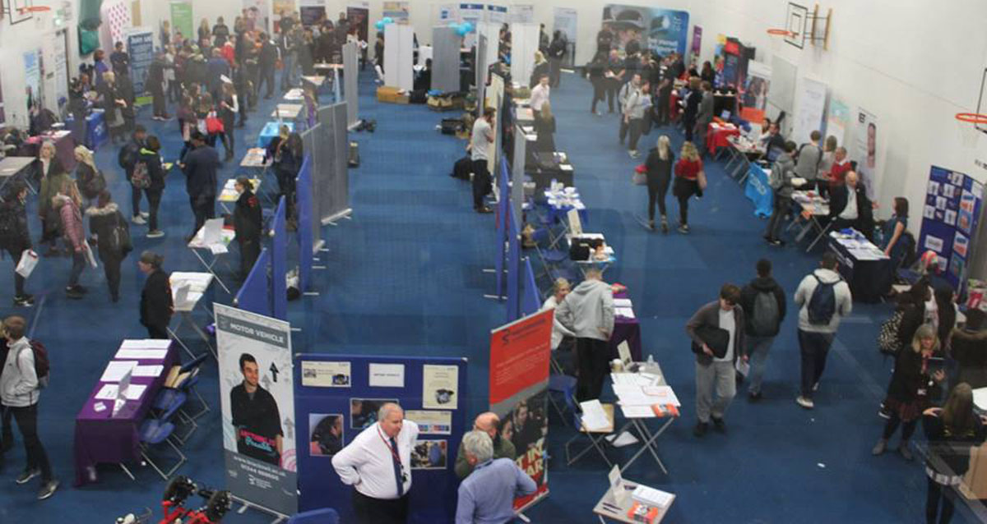
During National Apprenticeship Week the College opened the doors to the general public from all over Berkshire to offer help and advice on apprenticeships and careers with over 30 employers attending and recruiting.

Slide 15
Recommended action
Register with NAS site
https://www.gov.uk/apply-apprenticeship
For current vacancies:
http://www.activatelearning.ac.uk/courses/apprenticeships/vacancies

Slide 16
THANK YOU FOR LISTENING

